Slide 1
Chapter 5 Importing Spatial Data
Presented by Chris Dant

Slide 2
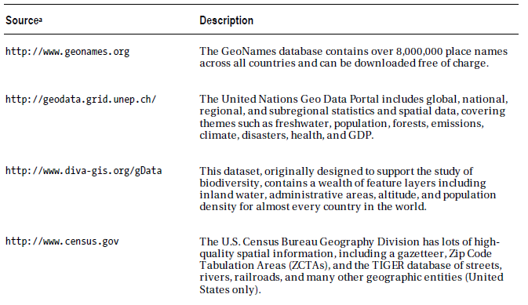
Sources of Spatial Data

Slide 3
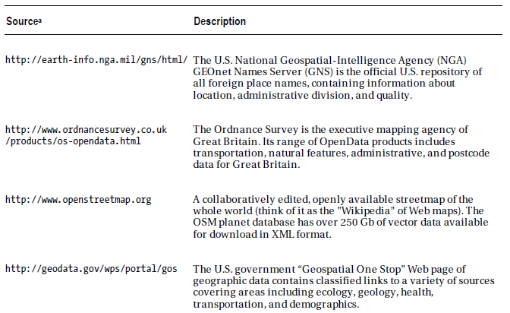
Sources of Spatial Data

Slide 4
Importing Tabular Spatial Data
The most abundant and simplest source of spatial data
Just a list of names of places along with longitude and latitude; sometimes accompanied by other data as well
There are a number of ways to import tabular data; for our example we use the Import and Export Wizard

Slide 5
Importing Tabular Spatial Data
The most abundant and simplest source of spatial data
Just a list of names of places along with longitude and latitude; sometimes accompanied by other data as well
There are a number of ways to import tabular data; for our example we use the Import and Export Wizard

Slide 6
Comparing Computed, Noncomputed, and Persisted Columns
The Epicenter and Hypocenter columns in the last example seem to behave the same, but they’re quite different in implementation
The Epicenter column is computed, which means the Point data is only created when a query is run and is therefore dynamic, updating based on the data used to create it
The Hypocenter column is noncomputed, so the point data always exists once defined and is static, so must be updated with a query to update
There are advantages and disadvantages to both methods
A computer column requires less space in the database but requires far more computation at query time

Slide 7
Comparing Computed, Noncomputed, and Persisted Columns
It is often easier to manage multiple columns of coordinate data rather than a single column of compound data; the geospatial datatypes must be recreated entirely in order to be updated
Since computed column data only exists at runtime, it is generally not possible to create an index on them which is vital for achieving good performance
A third option, called a persisted computed column, is a combination of the other two
A persisted column contains data that is generated using a defined calculation; the data is stored and only updated using the calculation when the sources used in the calculation are themselves updated

Slide 8
Importing Data Using OGR2OGR
OGR2OGR is a component of the Geospatial Data Abstraction Library, more commonly referred to as GDAL
GDAL is an open-source library and command-line toolkit that provides various utilities to read and write from different spatial data formats
The OGR sublibrary provides support for vector data, including ESRI shapefiles, MapInfo files, KML, GML, and various spatial databases including PostGIS, Oracle Spatial, and SQL Server
The GDAL/OGR library is relatively mature, powerful, and has an active development community
It's also free, and licensed under a permissive MIT-style open source license

Slide 9
Importing Data Using OGR2OGR
Installing OGR2OGR:
Library of binaries for open-source geospatial tools: http://osgeo4w.osgeo.org
Must have version 1.8.0 or later to have SQL Server support
Download an installer and follow the steps, making sure to install the GDAL package

Slide 10
Importing Data Using OGR2OGR
Basic syntax:
Display usage options:
Load information from a source to a destination:
Example of what we want to do:

Slide 11
Importing Data Using OGR2OGR
Useful additional options:
-append: appends new records into an existing table with the specified name.
-overwrite: deletes the existing destination table and re-creates it.
-nln "tablename“: inserts data into the named table rather than the default table named based on the {Source} dataset name.
More options are available, but were not discussed in the text

Slide 12
Importing ESRI Shapefile Data
The shapefile format was designed and is maintained by Environmental Systems Research Institute, Inc. (ESRI)
Very common format for exchanging spatial data between all kinds of systems
Most commercial data is in this format
A single shapefile actually consists of a set of files:
.shp: The SHP file contains the raw geometrical shape data
.shx: The SHX file maintains the shapefile index, which holds one index entry for every shape in the shapefile document
.dbf: The DBF file contains additional nonspatial attributes of each shape
.prj: The PRJ file gives details about the projection in which the coordinates of the geometry data are represented

Slide 13
Importing ESRI Shapefile Data
Our sample data: http://hubmaps1.cityofboston.gov/datahub/
You will likely need to use Internet Explorer to access this site

Slide 14
Assigning an Output SRID
The following query will return the SRID for our ESRI precincts table
The resulting value will not be correct, or even a valid SRID at all!
OGR2OGR uses that arcane value to indicate to valid SRID was found
To correct this issue you can update the SRID after the data is imported:

Slide 15
Assigning an Output SRID
Alternatively, we can force OGR2OGR to use the correct SRID in the first place:

Slide 16
Importing MapInfo Data
MapInfo Professional is a Geographic Information System (GIS) for Windows platforms often used in public sector organizations
MapInfo datasets are saved in an ASCII text format, either using the native .tab file extension, or saved as a MapInfo Interchange File (MIF), which typically comes as a pair of files with .mif and .mid extensions
Sample data: http://www.ga.gov.au/metadata-gateway/metadata/record/gcat_42343

Slide 17
Determining the SRID
Our sample data has no attached SRID
To determine the SRID:
We find this on the download page:
Australia's River Basins 1997 data is available in geographical coordinates (latitude and longitude) in decimal degrees using the Australian Geodetic Datum (AGD66).
We can then use this query to extract the SRID from SQL:
We find that the SRID is 4202

Slide 18
Reprojecting Data During Import
We’ve been using the –a_srs option to assign the SRID to the data in SQL server to be the same as the source of our data
OGR2OGR allows us to also reproject the data using a different SRID using the –t_srs option:
If you render the resulting table, you will get the precincts as before with a different SRID

Slide 19
Spatial ETL Using SQL Server Integration Services
This can be used to automate the creation and updating of spatial data from specified information sources
This is for when you have a significant need
Lots of data
Spatial data that changes significantly or needs to be highly accurate
The book has an exhaustive tutorial on how to set up SSIS for spatial systems

Slide 20
Exporting Spatial Data from SQL Server
Our main focus has been importing data, but OGR2OGR can also be used to export data from SQL to various formats
We use the same basic pattern as an import except our source is the database and the destination is the filename of the target file
Instead of exporting an entire table, we can use the –sql option to export only the data returned by a query
In our example, we will export the precinct data to a KML file

Slide 21
Keyhole Markup Language (KML)
Keyhole Markup Language is an XML-based language originally developed by Keyhole Inc. for use with its EarthViewer application
Keyhole Inc. was bought by Google, and EarthViewer is now Google Earth
KML is still used as the native format for Google Earth data
KML is an OGC-compliant standard since 2008
Due to the popularity and accessibility of Google Earth, it’s becoming a widely used language for education and research

Slide 22
Questions?

